Slide 1
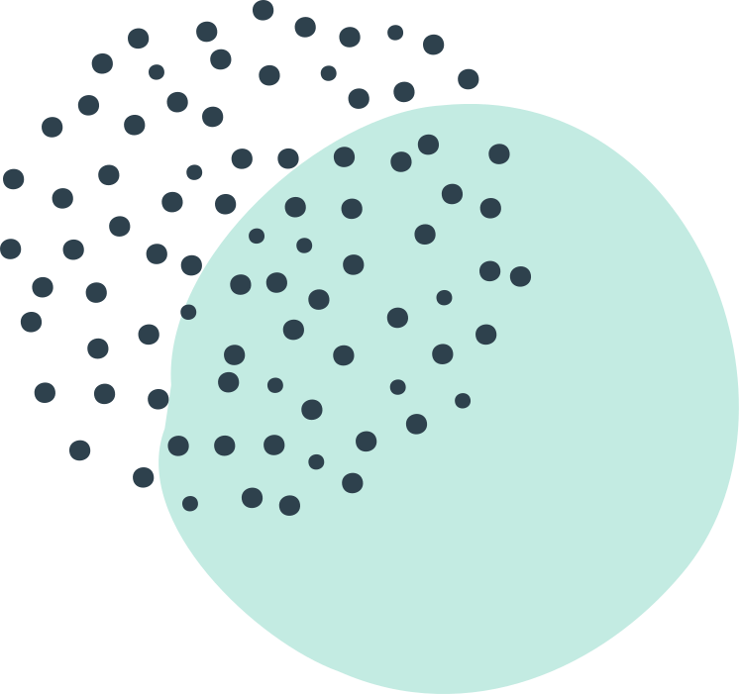
USING THE GO1 APP IN MICROSOFT TEAMS

Slide 2
Today's Presentation
POINTS COVERED
Introduction to Go1
How to install Go1
Structuring resources in MS Teams using Go1
Tracking of resources

Slide 3
88%
THE EDUCATION REVOLUTION
OF SCHOOLS AND COLLEGES ARE EXPERIMENTING WITH NEW METHODS OF LEARNING

Slide 4
What is Go1?
NOT JUST AN APPLICATION
Global Company supporting and providing digital learning resources
BENEFITS
Free to BLC members and the ability to add SCORM resources to Microsoft Teams

Slide 5
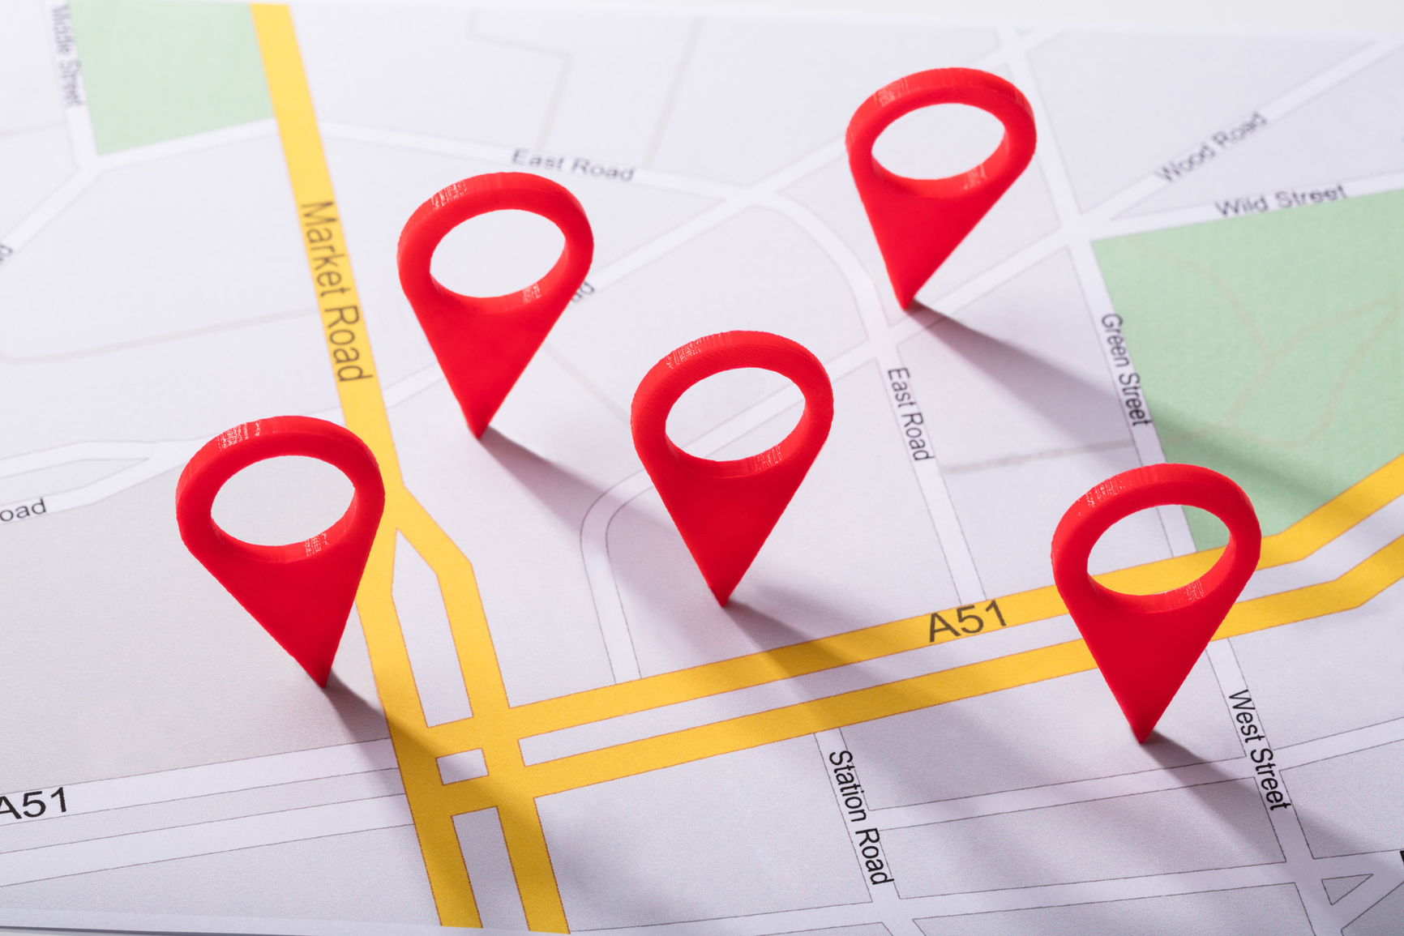
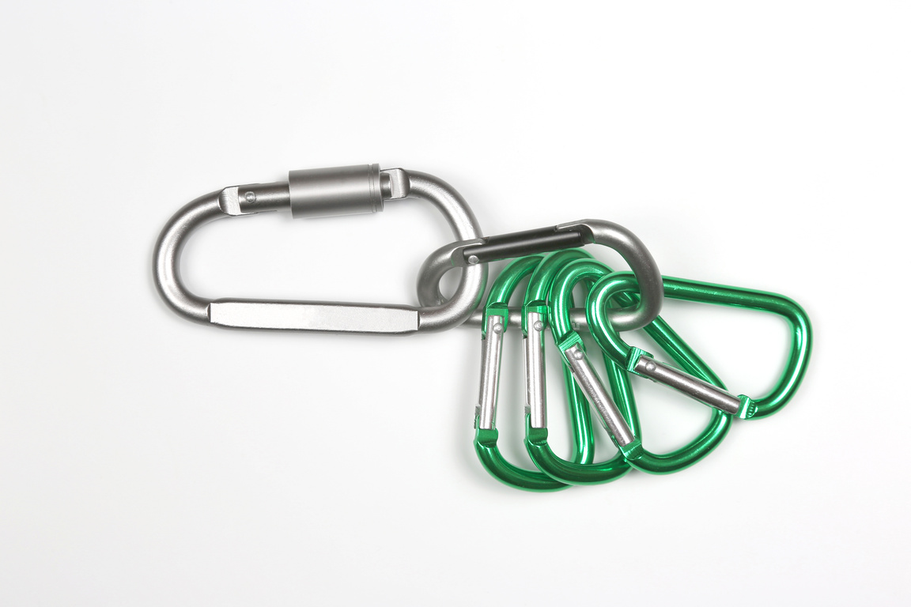
KEEPS IT WITHIN TEAMS
Same platform
Single sign ons
Mobile supportive
Use of Go1 in Teams
CREATES AN ENVIRONMENT
Digital check in's
Inclusive & supportive
Accessible
LINKING WITH OTHERS
Collaboration
Instant feedback
Sequenced

Slide 6
ENHANCING TEACHING, LEARNING AND ASSESSMENT
Access at all times
Positive environments
Monitor and track
Skill development
Peer to peer

Slide 7
Now for a Demo...

Slide 8
Support from Go1 and the BLC
BLC Team
blended-learning@howcollege.ac.uk
Go1
support@go1.com
Onboarding
Effective usage
Integration
Reporting and Tracking

Slide 9
Thank you......
ANY QUESTIONS?

